Slide 1


Customer
Intelligence
Portal
Rose Miao
Tanu Sharma
Vrinda Sehgal
Vrushti Khajanchi
Guided by: Professor Tao Li
Notes:
Vrinda

Slide 2
Project Outline
1
7
2
8
3
9
4
10
5
11
6
12
Problem Statement
Meta Data
Project Objective
Sentiment Analysis
Project Scope
Key Words
Architecture Diagram
Benefits to AWS
Data Scraping
Next Proposed Steps
Data Cleaning
Learnings
Notes:
Vrinda

Slide 3

Problem Statement
The problem is the lack of efficient systems to prioritize sales actions for the AWS teams. This leads to challenges in identifying high-potential customers, resulting in missed opportunities. The absence of central repository of customer insights exacerbates the issue, hindering accurate and up-to-date information gathering for effective actions.
Notes:
Vrinda

Slide 4

Project Objective
To build a Customer Intelligence portal that provides ‘Single source of truth’ about AWS customers and serves as a knowledge base for the field teams (e.g.: Solutions Architect) to drive ‘Next Best Action’ for their customers.
Notes:
Vrinda

Slide 5
Project Scope
Our project involves extracting, cleaning, and analyzing data for nine companies. We will gather data from multiple sources, perform sentiment and text analysis, analyze metadata for insights, generate word clouds of key words, and develop a visualization dashboard.
Notes:
Vrinda

Slide 6
Dashboard Demo

Slide 7
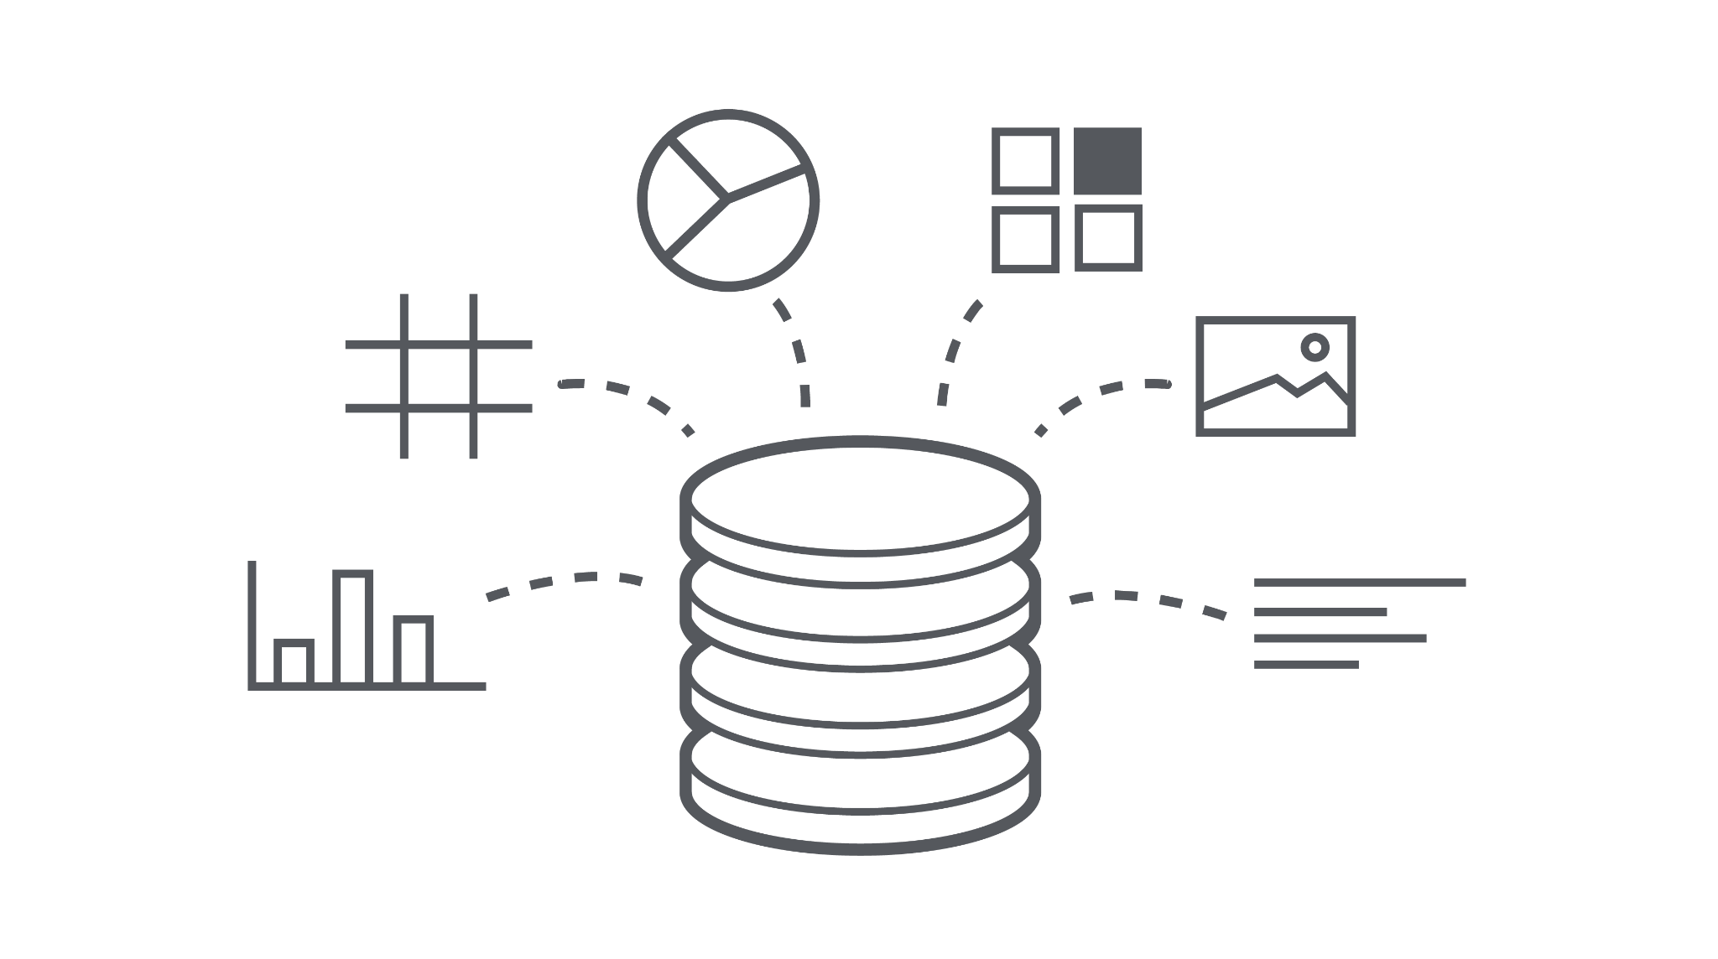



Architecture flow diagram
Data Analysis
Data Representation
Data Gathering
Data Cleaning
Data Interpretation
Notes:
Rose

Slide 8
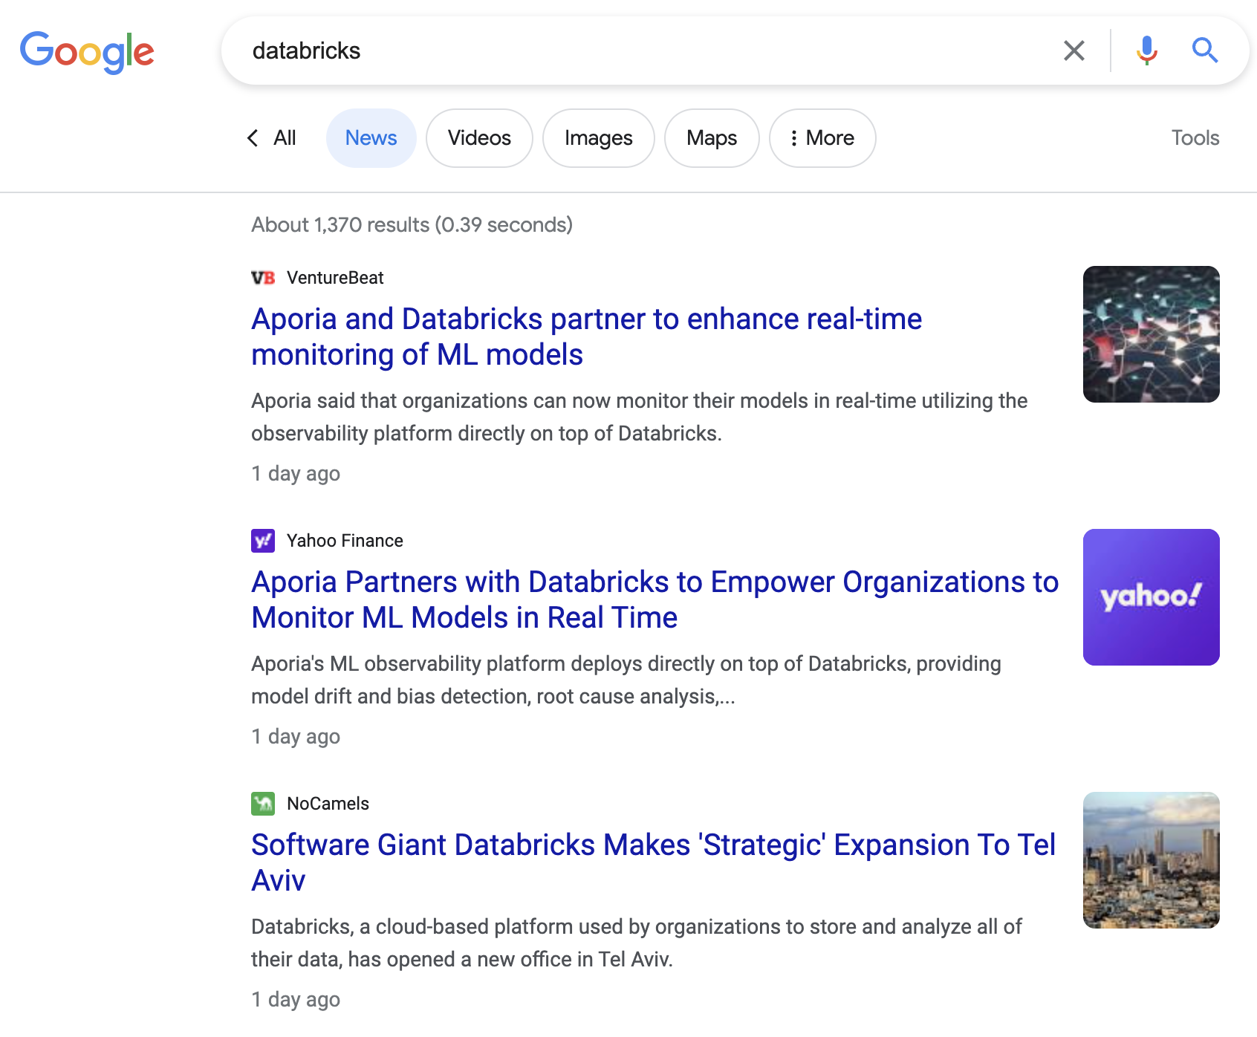
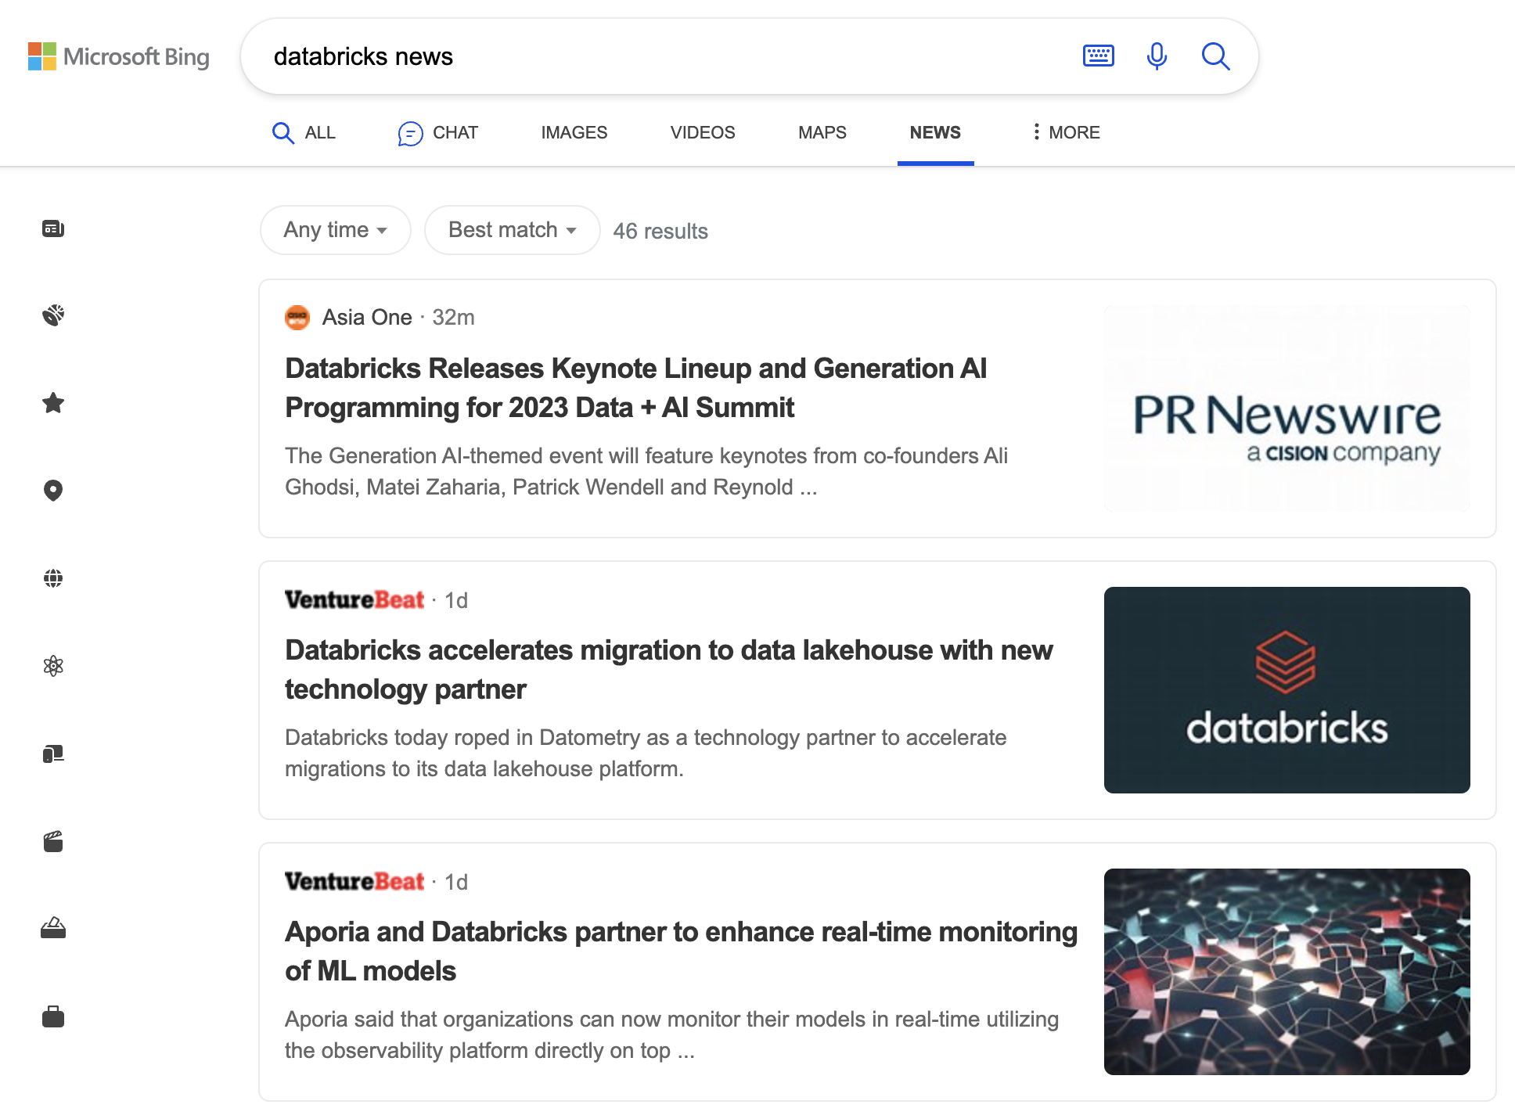
Data Scraping
Notes:
Rose

Slide 9
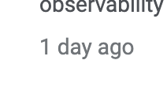
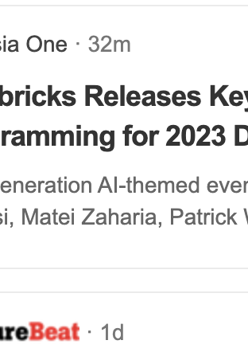
Data Cleaning
Fix date formatting issue:
Python dataframe
Notes:
Rose

Slide 10
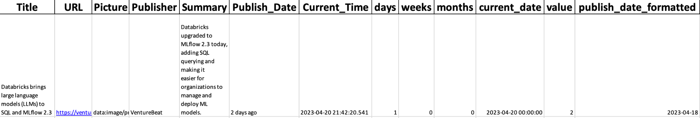
Data Cleaning
Notes:
Rose

Slide 11
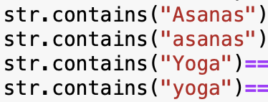
Data Cleaning
Fix irrelevant news
Notes:
Rose

Slide 12
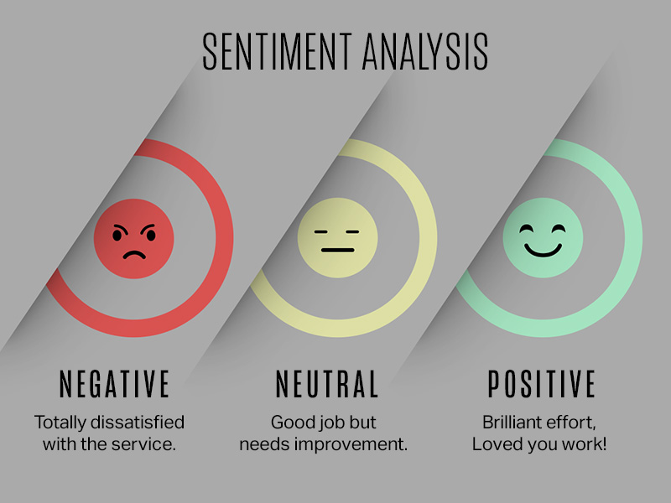
Sentiment Analysis
To understand the kind of overall sentiment attached to a company
Notes:
Vrushti

Slide 13


Different libraries explored
NLTK
Gensim
Negative, neutral, positive type
Compound scores
Word tokenization
Sentiment score for each word
Transformers
TextBlob
Positive, negative and neutral sentiment score
Polarity and subjectivity
Positive and negative sentiment
Neutral sentiment ignored
Notes:
Vrushti

Slide 14
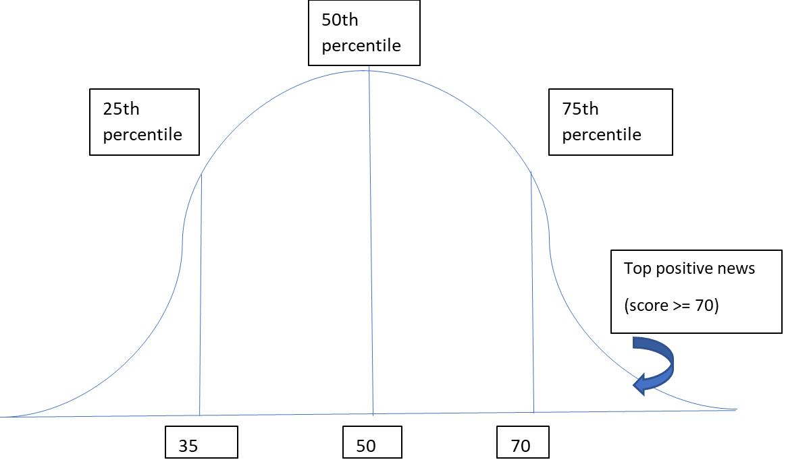
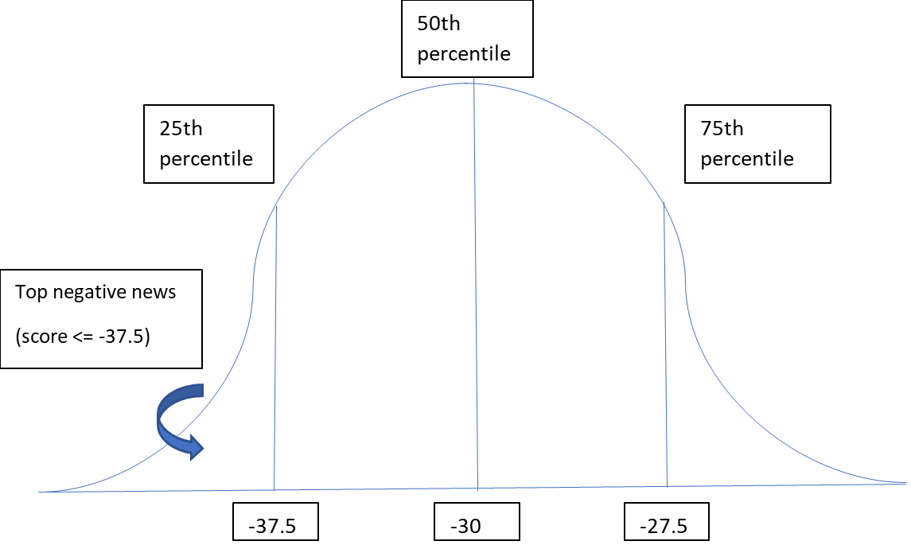
Threshold for sentiment type
Removed headlines with neutral sentiment (sentiment score = 0)
Separated positive and negative headlines and calculated respective percentile scores
Example: Calculated 75th percentile for positive sentiment score and 25th percentile for negative sentiment score
Notes:
Vrushti

Slide 15

Meta Data
To understand the companies management, new trends and overall performance

Slide 16
Meta Data
To ensure a transparent data collection process, we obtained relevant metadata from reputable sources like crunchbase, Yahoo Finance,Google Data ,Pitchbook and others.
We focused on specific data categories for all companies and select pertinent columns for further analysis. The meticulous approach enables us to gather comprehensive information on each company and extract key metrics crucial for the project.
Using trusted sources helped us to maintain the integrity and the reliability of the data.
Notes:
Vrinda

Slide 17
Meta data headers
1
7
2
8
3
9
4
10
5
11
6
12
Company name
Founders
Type of Company
No. of employees
Head office city
Funding Type
Industry
Head office state
CEO
Total Investors
Categories/Products
Money Raised
Notes:
Vrinda

Slide 18

High Impact
Key Words
To visually represent the prominent words
Notes:
Tanu

Slide 19

Key Word Approches
Generic Positive/Negative Word List
NLTK Library
Noun Extraction
Verb Extraction
Seed Word List
~1o words seed words
provided by AWS
High Impact Word List
Synonyms
Hyponyms
Derivatives
Takeover
Purchase
Merger
Buyout
……
…
.
Acquisition
Notes:
Tanu

Slide 20
Benefits to AWS
Improved Sales Effectiveness
A More Accurate Customer Portrait
Saves Time for Customer Research
Data-Driven Decision-Making
Personalized Customer Engagement
Notes:
Rose

Slide 21

Next proposed steps
Replicate the dashboard using in-house AWS tools and services (SageMaker, Comprehend, Quicksight)
Make the dashboard dynamic in nature by introducing auto-update feature for all sections
Integrate the Customer Intelligence Portal with existing software used by AWS to compare services already in use and future opportunity scoping
Notes:
Vrushti

Slide 22
Learnings
Data extraction techniques
Data cleaning and preprocessing
Sentiment and text analysis
Insights generation
Domain knowledge
User-centric design
User feedback and iteration
Product development experience
Notes:
Data extraction techniques: Gaining experience in extracting data from diverse sources, such as databases, APIs, or web scraping, and understanding the challenges and best practices involved.
Data cleaning and preprocessing: Developing skills in cleaning and preprocessing data to ensure its quality, consistency, and suitability for analysis.
Sentiment and text analysis: Acquiring knowledge and techniques for analyzing sentiment and text data, including understanding sentiment analysis algorithms and text processing methods.
Insights generation: Learning how to derive meaningful insights from the analyzed data, identifying patterns, trends, correlations, or anomalies that can provide valuable information to stakeholders.
Domain knowledge: Developing domain-specific knowledge about AWS, understanding the data requirements, challenges, and specific analytical needs.
User-centric design: Understanding the importance of designing dashboards that cater to the specific needs and preferences of the intended audience or users.
User feedback and iteration: Gathering feedback from AWS on their requirements and preferences, and incorporating that feedback into the dashboard design through iterative improvements and revisions.
Product development experience: Worked on the project from ideation phase to final result during which we learnt various aspects and nuances of product development.

Slide 23
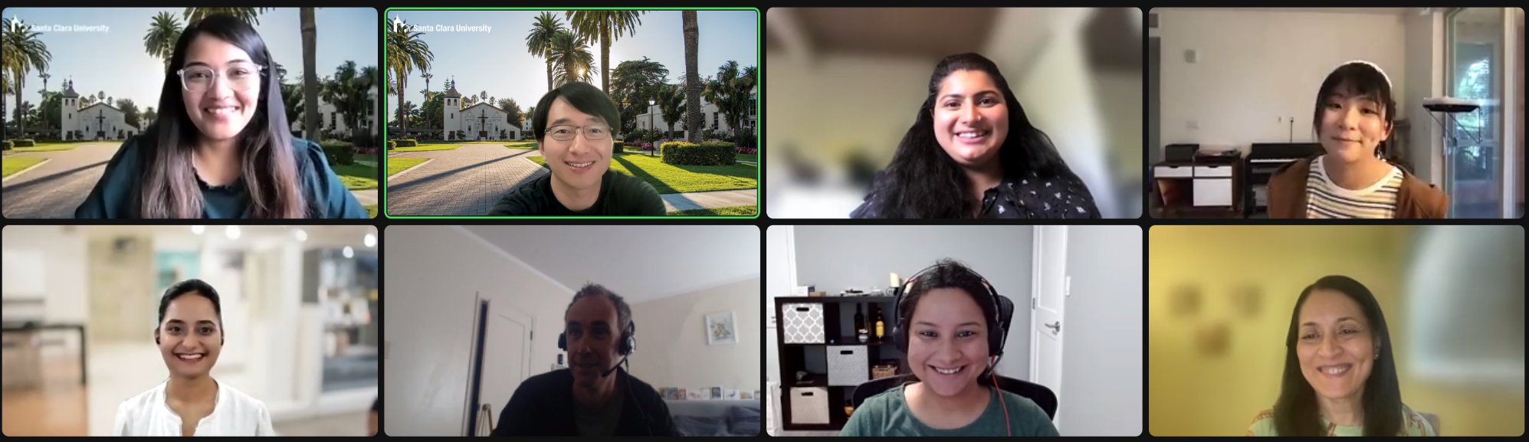
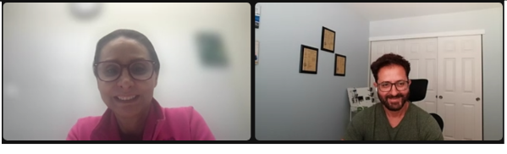
Notes:
We had the opportunity to present our project to the entire AWS team and this is the screenshot from that presentation.

Slide 24

Feedback from AWS
I really like the idea of a browser on the dashboard.
It is useful beyond AWS too
We loved the presentation
I like how the words are getting highlighted within the news headline.
I like how you have good knowledge of the domain
We love the effort and complexity you have put in to make this intuitive dashboard
This has turned out to be a great project with great results. You really worked like a startup.
As of today, I can use what you have built
Great Job!
Well planned out
Fantastic Job!
Thank you for incorporating all the feedback
This is a very good presentation and nice project implementation!
Notes:
These are the feedbacks that we received from AWS in that presentation.

Slide 25

Thanks!
Do you have any questions?

